Slide 1
Unscented Transformation Unscented Kalman Filter Unscented Particle Filter
Dan Yuan
Nov 17, 2004

Slide 2
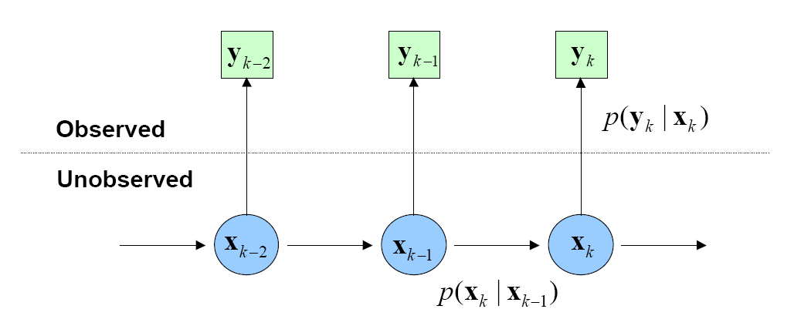
Filtering Problem
General Problem Statement
where x_{i} is the state, and y_{i} is the observation
Filtering is the problem of sequentially estimating the states (parameters or hidden variables) of a system as a set of observations become available on-line

Slide 3




Filtering Problem
Solution of sequential estimation problem given by
  Posterior density
  Marginal of the Posterior
One does not need to keep track of the history of the state sequence

Slide 4
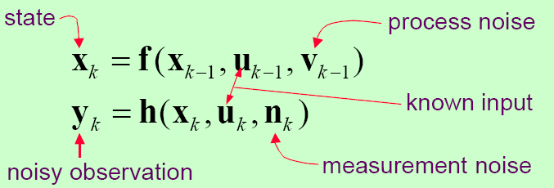
Dynamic State Space Model
General discrete time non-linear, non-Gaussian dynamic system
Assumption:
States are markovian, i.e.,

Slide 5
Filtering Algorithms
Kalman Filter (KF), Extended Kalman Filter (EKF)
  KF: Linear evolution functions; Gaussian noise
  EKF: Non-linear evolution functions; Non-gaussian noise
Monte Carlo Methods
  Particle filter: non-linear evolution functions; Non-gaussian noise

Slide 6
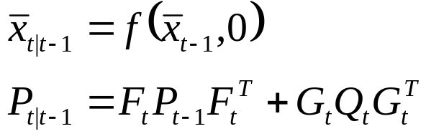
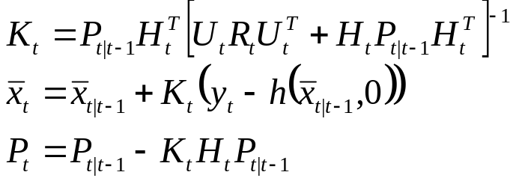
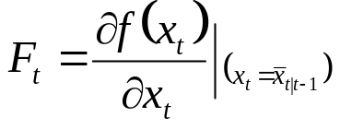
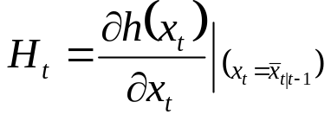
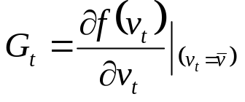
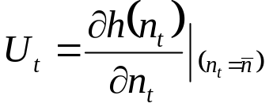
Solution by Extended Kalman Filter
Time update and measurement update framework (control input u is neglected)
Time Update:
Measurement Update:
K_{t} is Kalman Gain, Q is the variance process noise, R is the variance of the measurement noise

Slide 7
Crude Approximation by EKF
EKF uses first order terms of the Taylor series expansion of the nonlinear functions.
Large errors are introduced when the models are highly non-linear
Local linearity assumption breaks down when the higher order terms become significant.
Better Approximation ?

Slide 8
Outline
Unscented Transformation
Scaled Unscented Transformation
Unscented Kalman Filter
Unscented Particle Filter

Slide 9


Unscented Transformation
The unscented transformation (UT) is a method for calculating the statistics of a random variable which undergoes a nonlinear transformation and builds on the principle that it is easier to approximate a probability distribution than an arbitrary nonlinear function.
The Problem
  Propagating an n_{x} dimensional random variable x through a nonlinear function to generate y

Slide 10





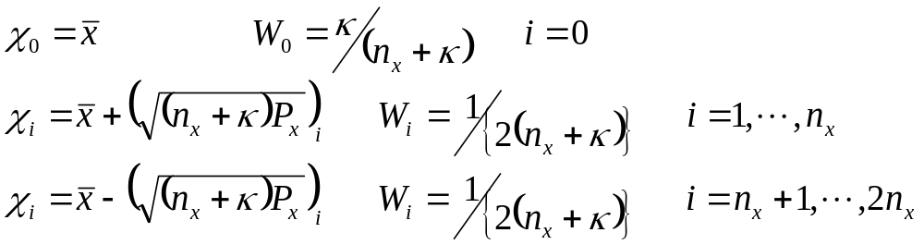





Unscented Transformation (cont’d)
Formulation
Assume has mean and covariance
A set of weighted samples or sigma points
are chosen as follows:
where is a scaling parameter and is the i th row or column of the matrix square root of is the weight associated with the i th point such that

Slide 11
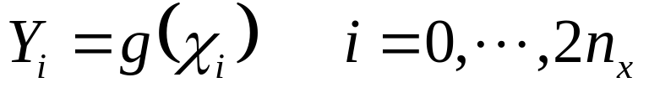
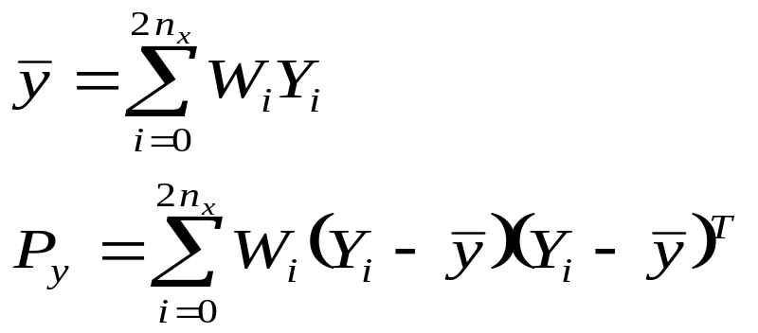
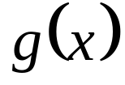
Propagation of Sigma Points
Each sigma point is propagated through the nonlinear function
and the estimated mean and covariance of y are computed as follows
These estimates of the mean and covariance are accurate to the second order of the Taylor series expansion of for any nonlinear function

Slide 12
Propagation of Sigma Points (cont’d)
Comparison
  The EKF only calculates the posterior mean and covariance accurately to the first order with all higher order moments truncated; however, UT calculates the mean and covariance to the second order.
  Detailed proof:
  Ref: Simon Julier and Jeffrey K. Uhlmann, A General Method for Approximating Nonlinear Transformations of Probability Distributions

Slide 13
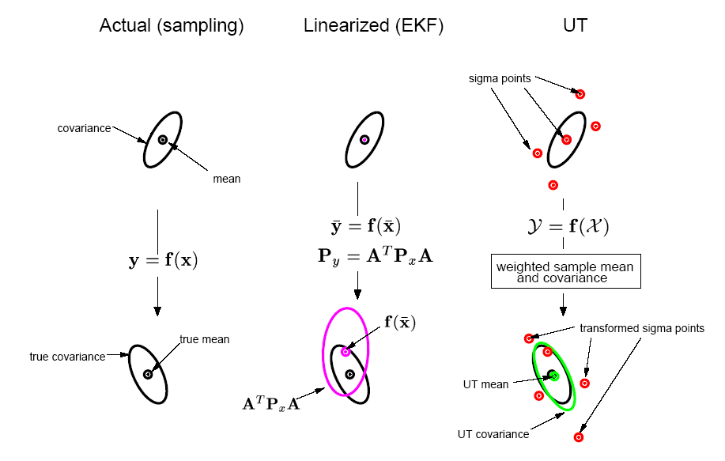
Example
A cloud of 5000 samples drawn from a Gaussian prior is propagated through an arbitrary highly nonlinear function and the true posterior sample mean and covariance are calculated, which can be regarded as a ground truth of the two approaches, EKF and UT.

Slide 14


The scaling factor
As the dimension of the state-space increases, the radius of the sphere that bounds all the sigma points increases. Even though the mean and covariance of the prior distribution are still captured correctly, it does so at the cost of sampling non-local effects.
These points are asymmetrically distributed about the mean. Higher order effects such as skew become more significant as the dimension increases.
The sigma points can be scaled towards and away from the mean of the prior distribution by a proper choice of

Slide 15
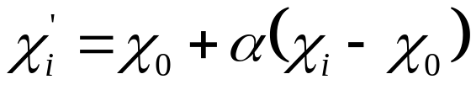

Scaled Unscented Transformation (SUT)
This improvement overcomes dimensional scaling effects by calculating the transformation of a scaled set of sigma points of the form
where is a positive scaling parameter which can be made arbitrary small to minimize higher order effects.

Slide 16
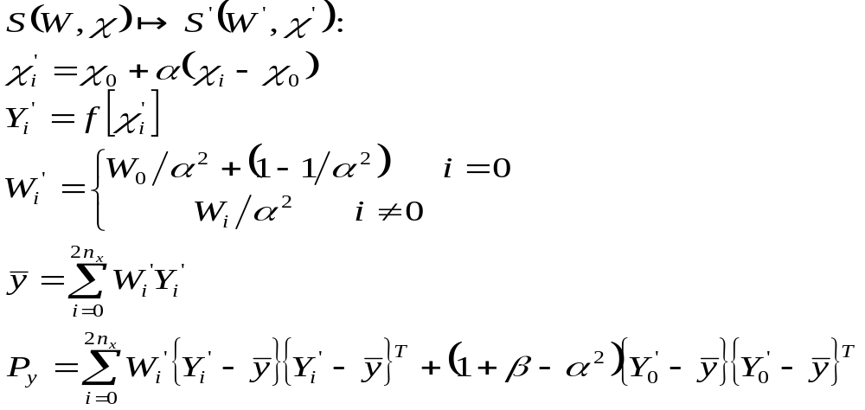

SUT Formulation
The scaled unscented transformation can be written as:
is a parameter which minimizes the effects from high order terms
Ref: Simon J. Julier, The Scaled Unscented Transformation

Slide 17
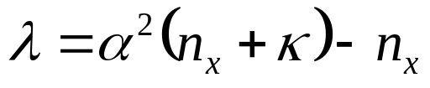
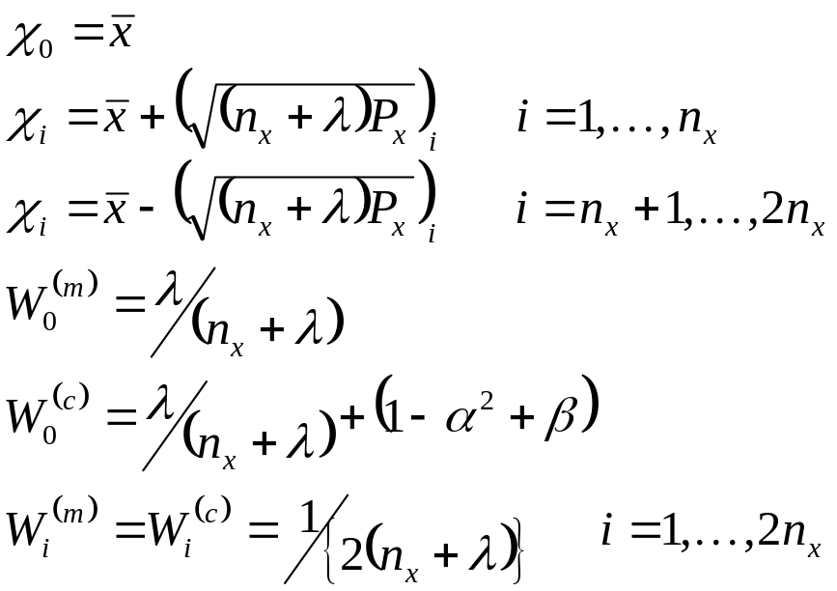
SUT Formulation
The sigma point selection and scaling can be combined into a single step by setting
and selecting the sigma points are set by:

Slide 18
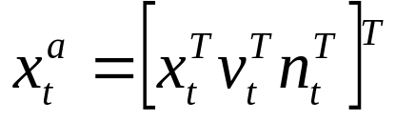
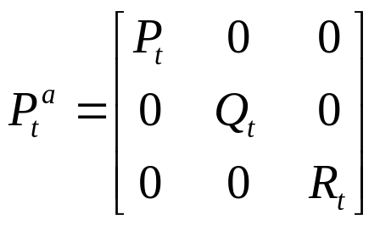
Unscented Kalman Filter (UKF)
The unscented kalman filter is a straightforward application of the scaled unscented transformation, where the state variable is an augmented vector and the covariance is also an augmented matrix

Slide 19
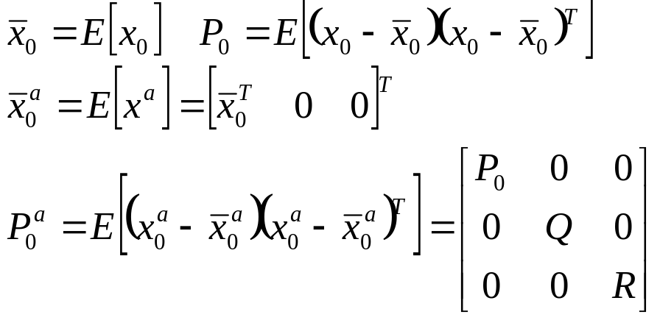
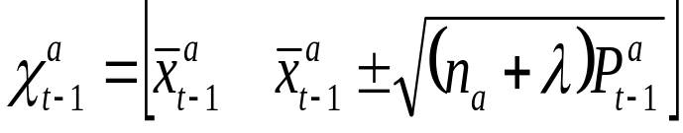
UKF Algorithm
The algorithm
1. Initialization
2. Updating
(a) Computing Sigma Points

Slide 20
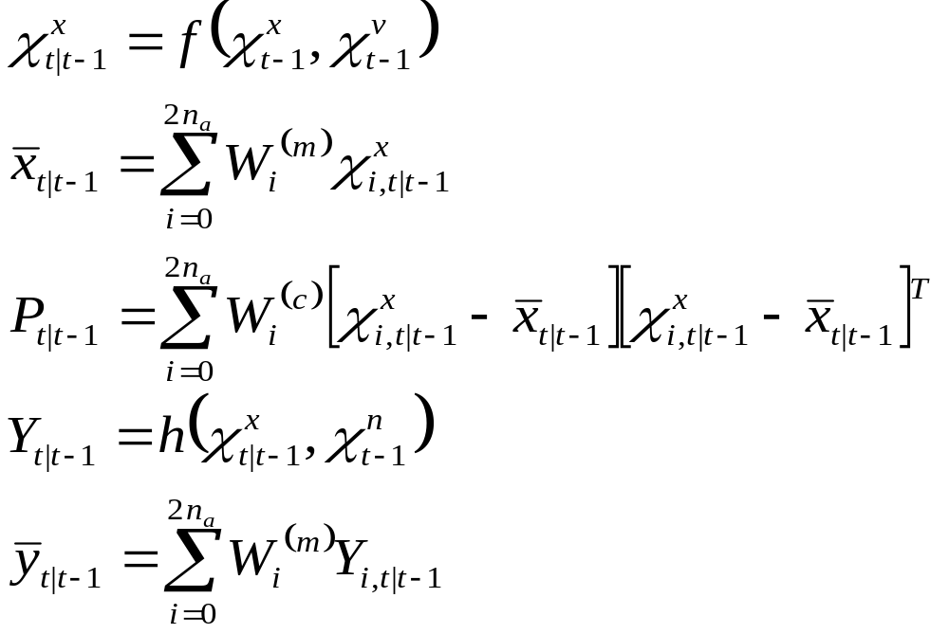
UKF Algorithm (cont’d)
(b) Time Update:

Slide 21
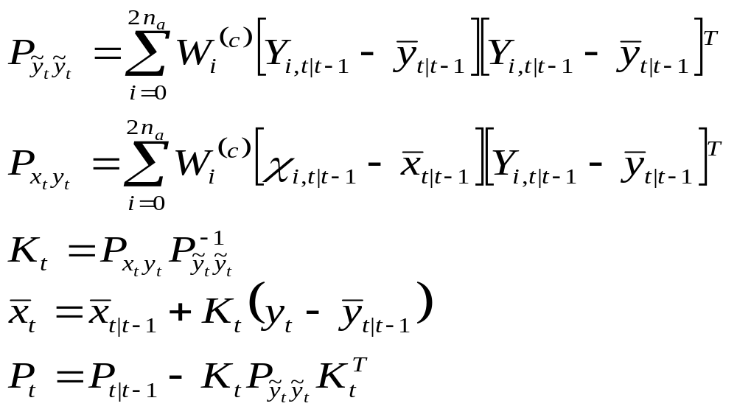

UKF Algorithm (cont’d)
(c) Measurement update
where,
composite scaling parameter, n_{a}=n_{x}+n_{v}+n_{n ,}
Q is process noise cov. R is measurement noise cov.
K is kalman gain, W is weights

Slide 22
Unscented Particle Filter--Outline
The statement of the problem
Sequential importance sampling
Generic particle filter (GPF)
Choices of proposal distribution in GPF
Unscented Particle Filter (UPF)

Slide 23

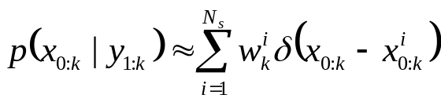
The problem
For the typical Bayesian Inference problem: given the observations up to time index k (y_{1:k}), we want to construct the posterior of the system state
Using Monte Carlo methods, the posterior could be approximated by a cloud of weighted discrete supports N_{s} is the number of the supports.

Slide 24

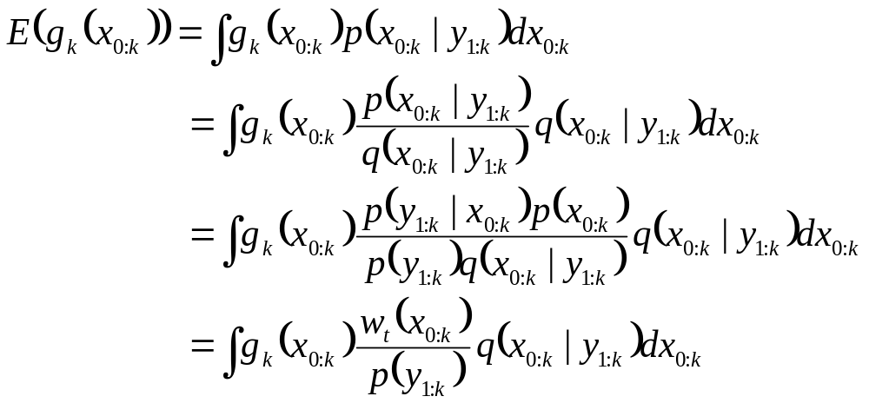

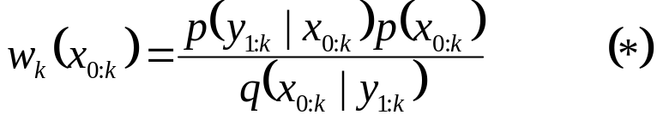
Importance Sampling
Unfortunately, it is often not possible to directly sample from the posterior density function; therefore, a proposal is introduced.
For any objective function of x_{0:k} , g(x_{0:k}), we have
where is the unnormalized importance weights.

Slide 25
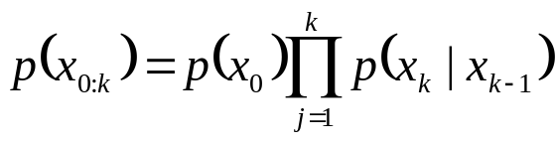
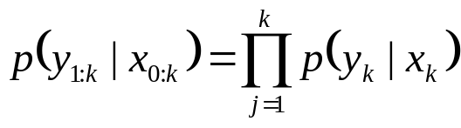
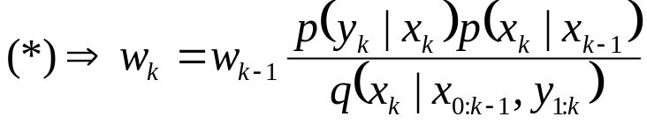
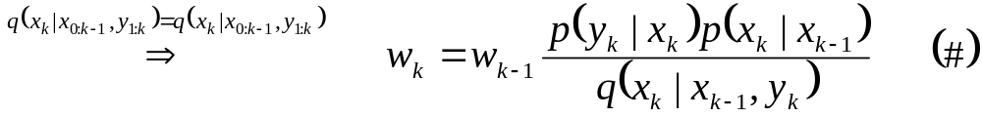
Sequential Importance Sampling
In order to compute a sequential estimate of the posterior distribution at time k without modifying the previously simulated states x_{0:k-1} , proposal distributions of the following form can be used
Under the assumptions that the states correspond to a Markov process and that the observations are conditionally independent given the states

Slide 26

Generic Particle Filter (GPF)
Algorithm
  For i=1:N_{s}
    Draw particles from the proposal q
    Assign the particle a weight, ,according to (#)
  End For
  Normalizing the weights
  <Re-sampling>
  … …
  … …

Slide 27
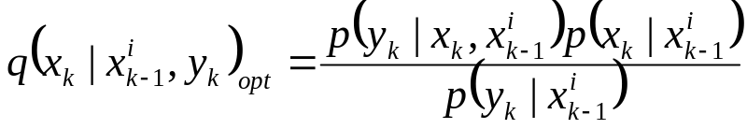


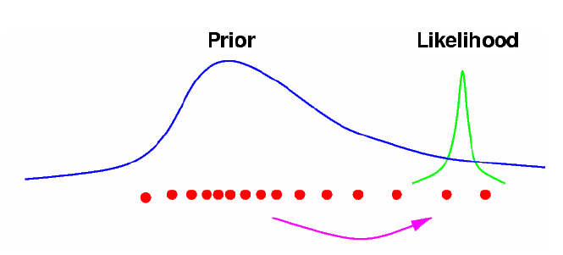
Choices of Proposal q
Optimal importance density
State transition prior
  No current observation incorporated
Ref: Yong Rui and Yunqiang Chen, Better Proposal Distributions: Object Tracking Using Unscented Particle Filter, CVPR 2001

Slide 28
Better Proposal—UKF
The unscented Kalman filter is able to accurately propagate the mean and covariance of the Gaussian approximation to the state distribution.
Big overlap between distribution by UKF and the true posterior distribution.
      UKF+GPF = UPF

Slide 29


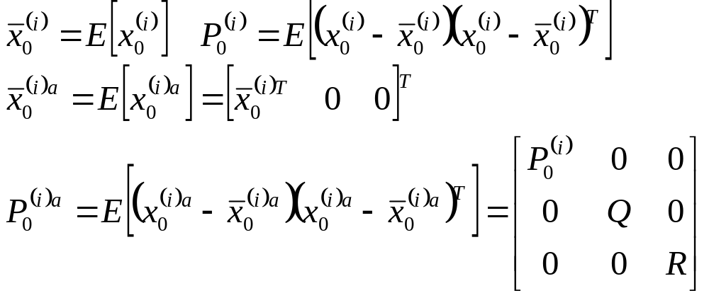
Unscented Particle Filter (UPF)
Algorithm
  Initialization
  For i=1:N_{s}, draw the states (particles) from the prior and set,

Slide 30

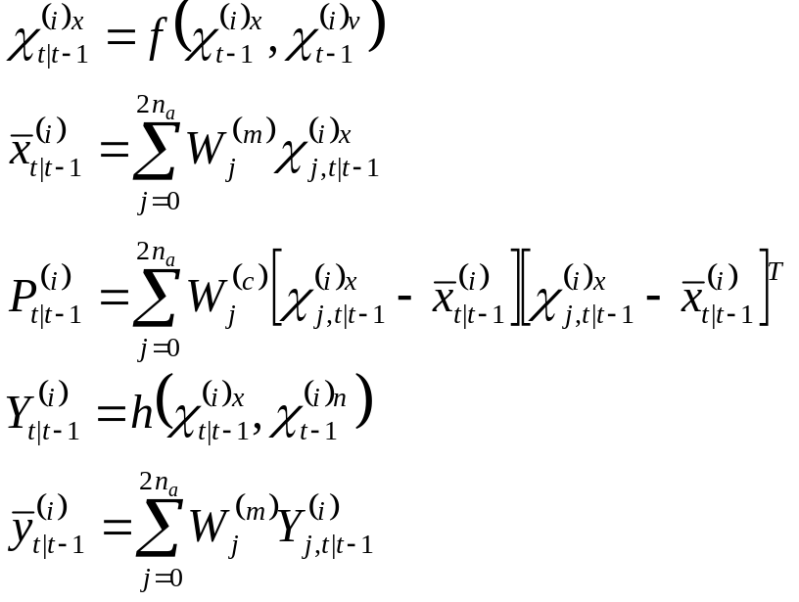
Unscented Particle Filter (cont’d)
2. For t= 1,2,…
(a) Importance sampling step
For i=1,…,N:
---update the particles with the UKF:
* Calculate sigma points:
* Propagate particle into future (time update)

Slide 31
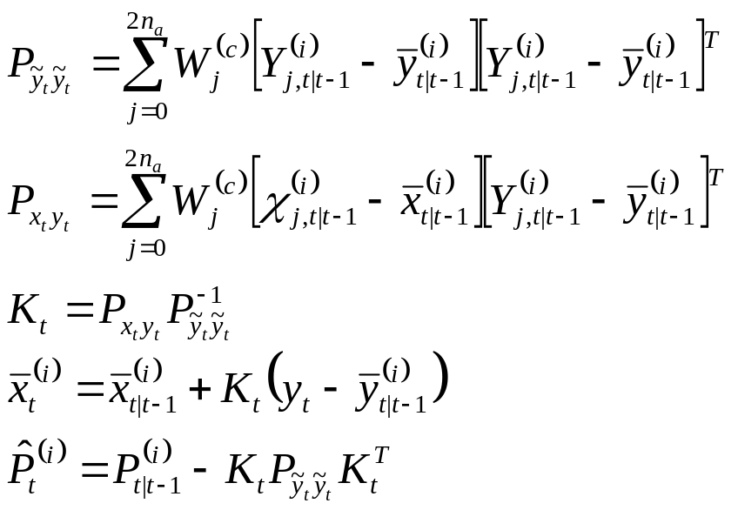

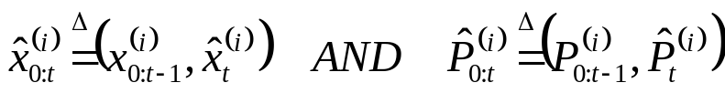
Unscented Particle Filter (cont’d)
        *Incorporate new observation (measurement update)
        --Sample
        --Set
        Updating weights according to (#) and normalizing them
        ……

Slide 32
Thank You

